Slide 1
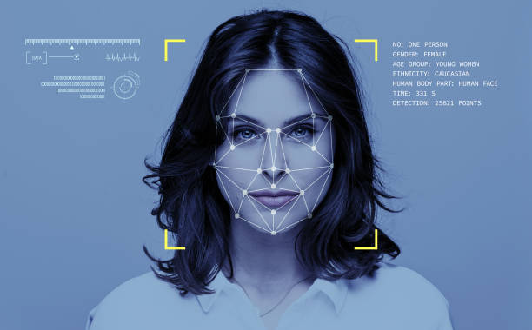
Age and Gender Detection
Elaboré par:
Manar Ouled Ahmed

Slide 2
Age and Gender Detection Using Deep Learning Algorithms
An overview of the use of deep learning algorithms and pretrained models in age and gender detection. Among the many areas of AI research, age and gender detection has gained popularity for its ability to automatically identify the age and gender of individuals in an image or video frame.Age and gender detection is a subset of computer vision, which uses algorithms to analyze and interpret visual information. The goal of age and gender detection is to predict the age and gender of individuals in an image or video, with a wide range of applications in marketing, security, and healthcare.

Slide 3

Machine Learning and Deep Learning Algorithms
AI has made significant strides in recent years with the development of machine learning and deep learning algorithms.
Machine learning and deep learning algorithms power age and gender detection.

Slide 4
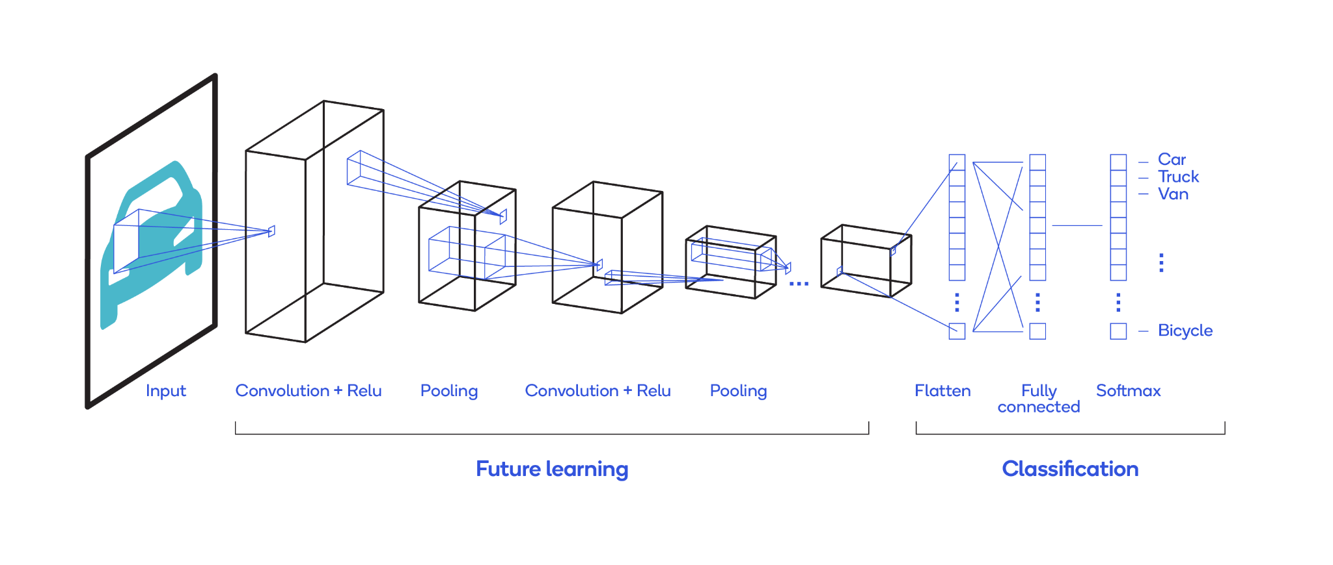
Use of Convolutional Neural Networks (CNNs)
CNNs are the most widely used deep learning algorithm in computer vision for age and gender detection.
CNNs extract features from images and videos automatically.

Slide 5
Pre-trained Models
Pre-trained models are commonly used in age and gender detection to identify faces in images.
Adience dataset is one of the most popular datasets used for training age and gender detection models.

Slide 6
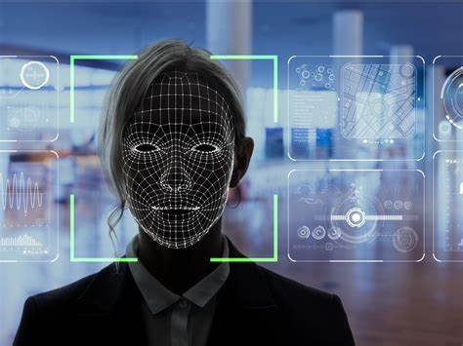
Face Detection
Age and gender detection involves three main steps, starting with face detection.
Face detection is performed using a model to identify faces in the image and create bounding boxes around them.

Slide 7
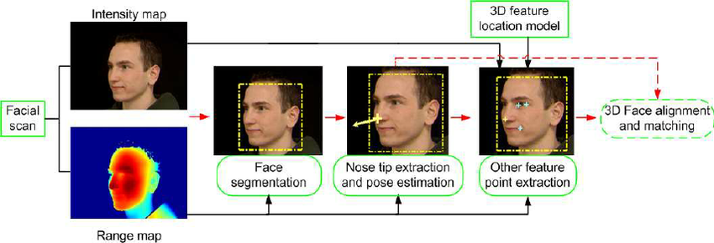
Face Extraction
After identifying the faces, the next step is to extract them and discard the rest of the image.
This is done by cropping the image to include only the face.

Slide 8
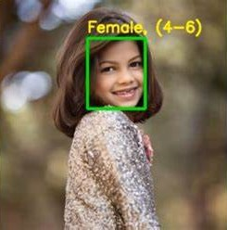
Age and Gender Prediction
The final step is to predict the age and gender of each face.
This is done by passing each face through the age and gender detection model.

Slide 9
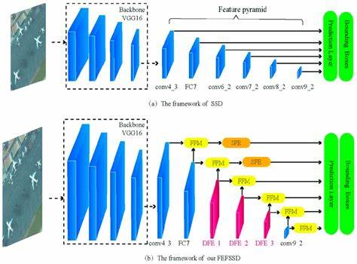
Single Shot MultiBox Detector (SSD)
SSD is a popular face detection model used in age and gender detection.
It is based on a deep neural network and designed to detect faces in images and videos.

Slide 10
Accuracy and Applications
The use of deep learning algorithms and pre-trained models has made it possible to accurately predict the age and gender of individuals in images and videos.
Age and gender detection has the potential for numerous applications in areas like security, marketing, and healthcare.

Slide 11

Challenges and Future Developments
One of the challenges in age and gender detection is preserving privacy and avoiding bias.
Future developments in age and gender detection include improving models for better accuracy and developing new applications.

Slide 12
Conclusion
Age and gender detection is a rapidly advancing field in AI research with significant potential for numerous applications.
CNNs, the Adience dataset, and the SSD face detection model are powerful tools for accurate age and gender detection.

Slide 13
Thank you for your time and attention 🙂

